Slide 1

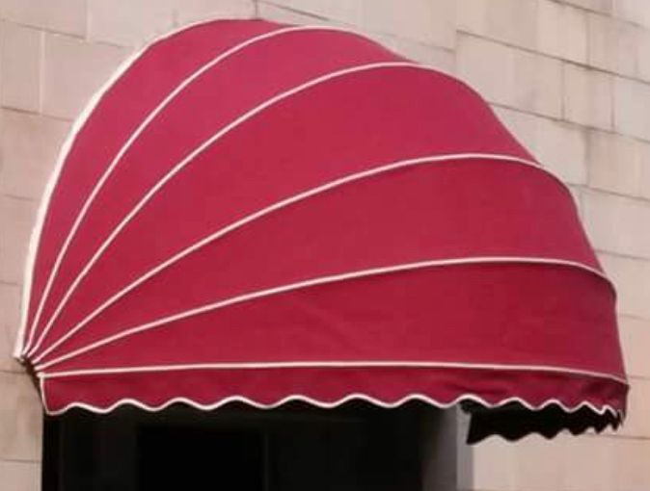
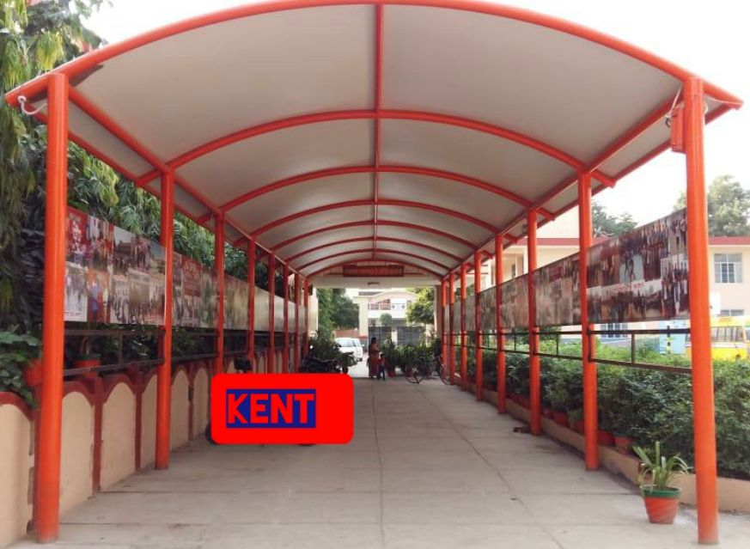
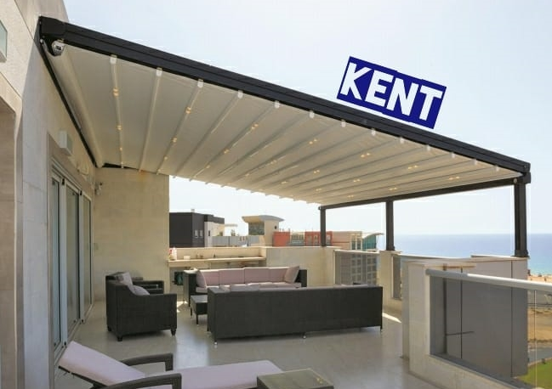
EXPERIENCE CENTER
541-542 Main Mehrauli Gurgaon Road , New Delhi
SHOWROOM
B 53, Main Road , Kalkaji , New Delhi
+91-9811195752
Obvious choice for high velocity wind areas
LED lights , Motorised mechanism makes it a users delight
Powder coated aluminium frame with front support of pillars
Provides shade to the window
Can be used as an effective tool
for branding
Folding mechanism can be incorporated
Enhances the look of any premises
Main application areas are Car parking , Mall entrance, Atriums , Walkways etc
Super finished aesthetic designs
No limit of size & no fear of air dynamics
TWO DECADES OF EXPERIENCE IN MANUFACTURING
AN ISO 9001:2015 CERTIFIED COMPANY
www.kentinternational.in

