Slide 1
ABOUT US
Kent International is into Manufacturing of Awnings ,using exclusive fabrics procured from world over.
We are an ISO 9001:2015 certified company with an expertise of more than 30 years.
Our inhouse expert technical team gives end to end solutions starting from scratch to finish.
The in-depth knowledge and right technical guidance has enabled us to work with prestigious clients like INOX, his holiness the Dalai Lama, Oil India, Max hospitals, Moolchand Hospital, India International Centre, Ambassador Hotel, Maruti Suzuki & many more.
We are located on the Main Mehrauli Gurgaon road, New Delhi

Slide 2
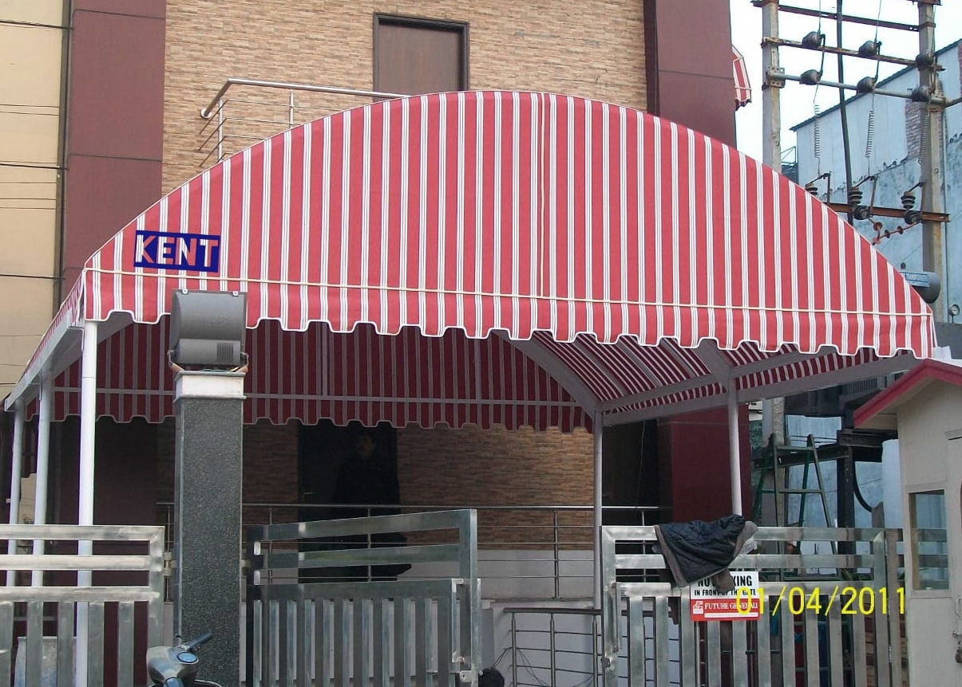
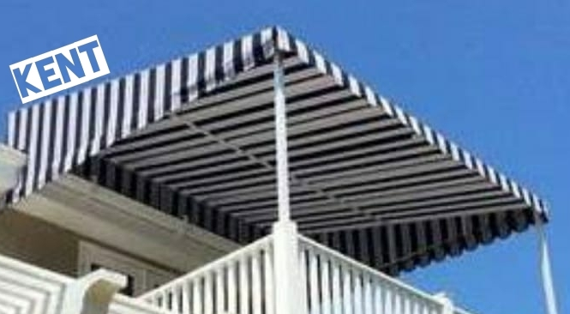
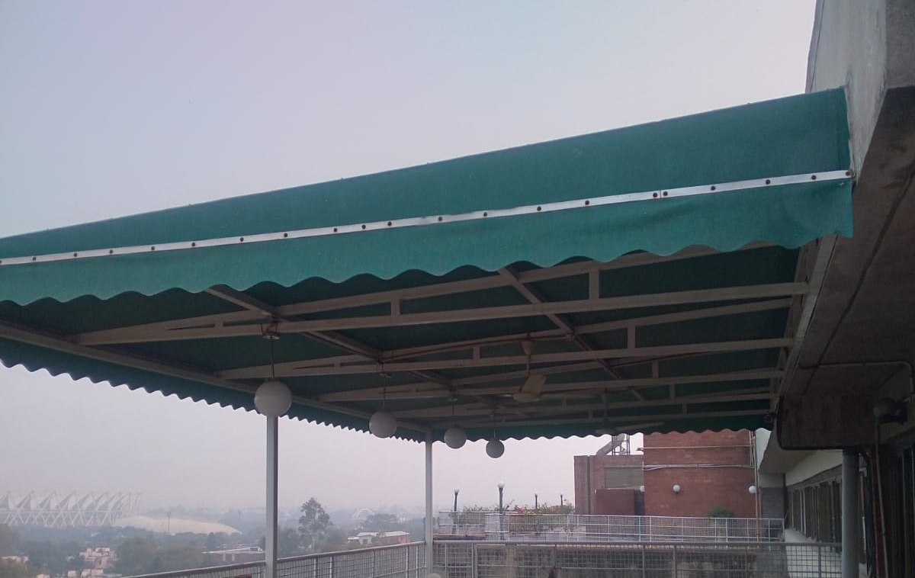
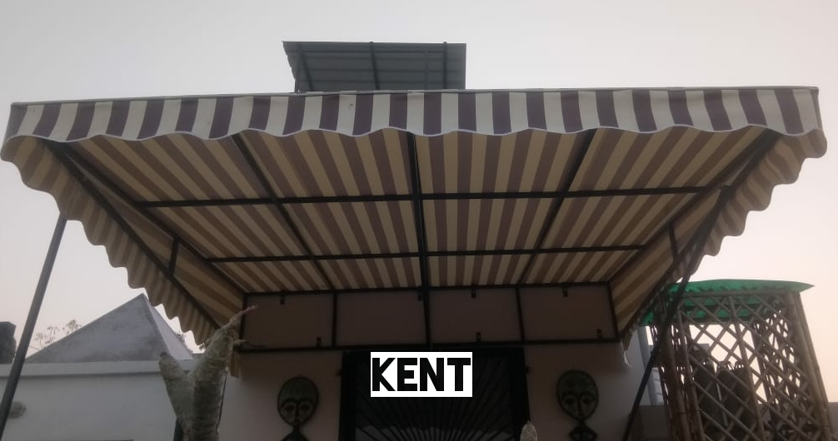
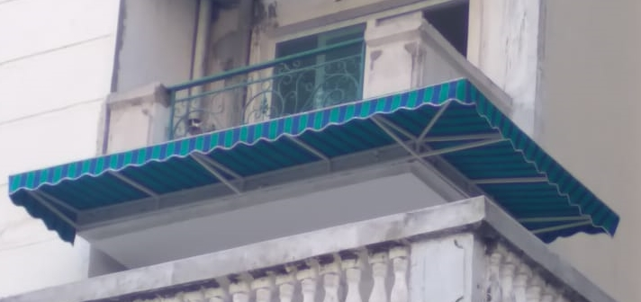
FIXED AWNING
Predominantly an exterior product
Can withstand extreme weather condition
Mild steel structure can take any shape or size , like L or U shape
Ideal for high rise buildings
Perfect for rooftop restaurants
Gives extra space for a sit out
Front pillars for extra support
Fabric used is 100% waterproof & UV protected

Slide 3
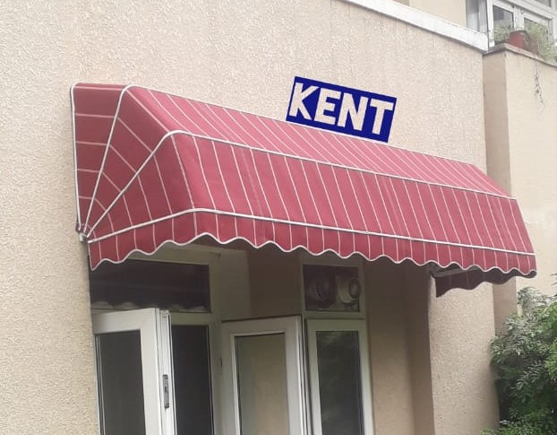
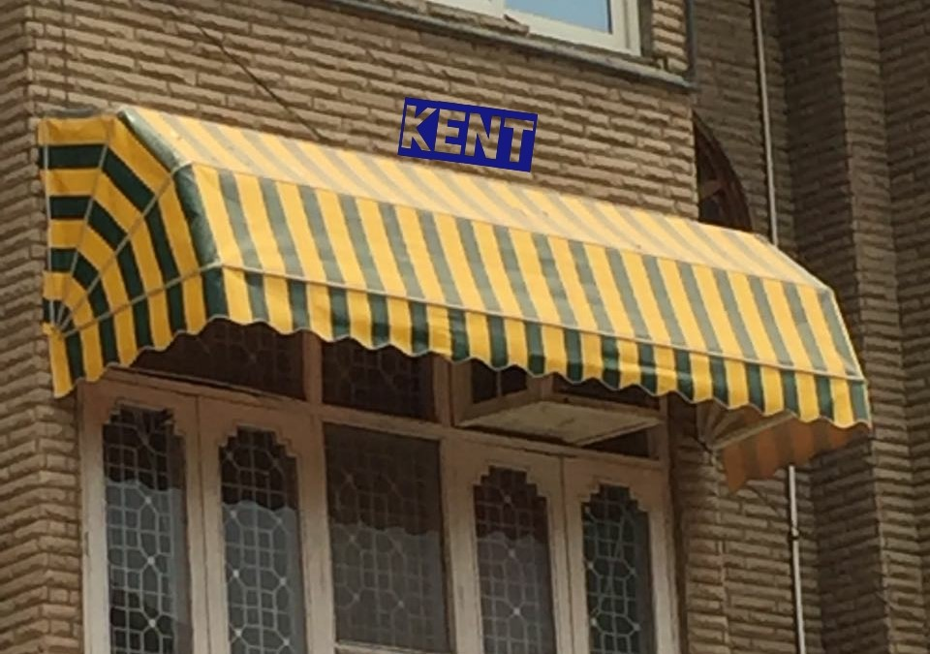
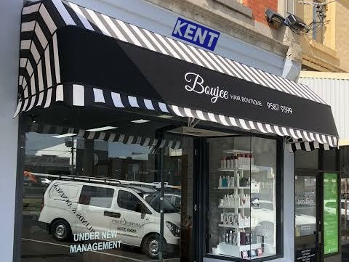
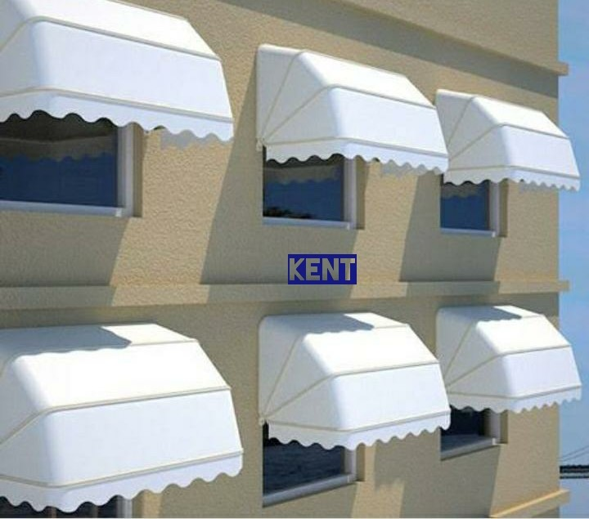
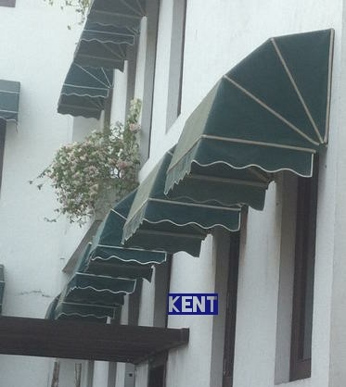
WINDOW AWNING
Provides shade to the window
It is a quarter of a circle shape
Frame is made of aluminium or MS powder coated
Folding mechanism can be incorporated
Enhances the look of any premises
Can be used as an effective tool for branding
Silicon coating done between frame & window wall

Slide 4
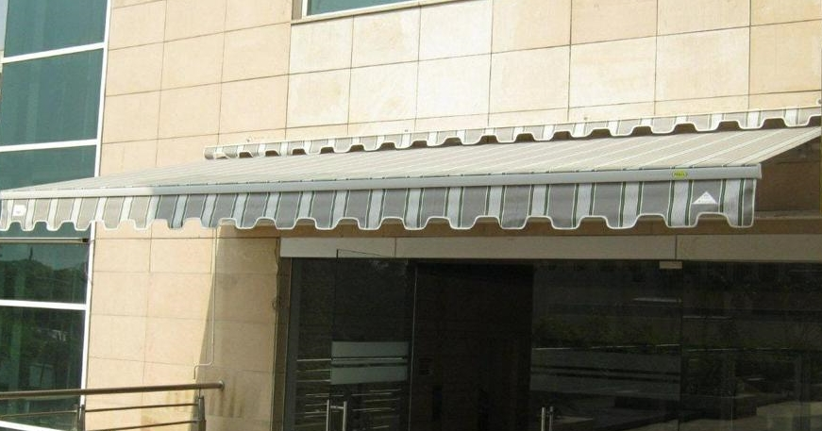
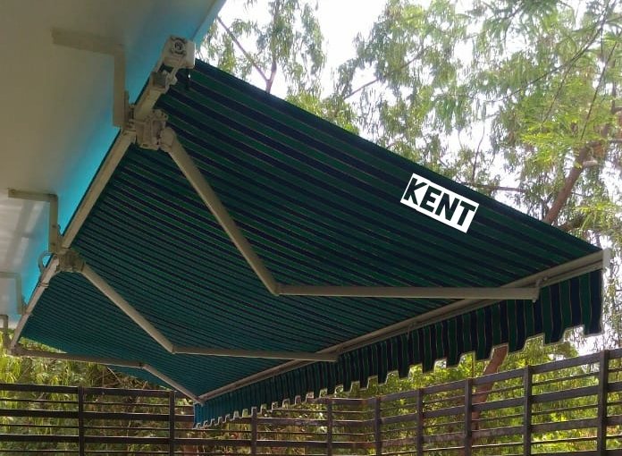
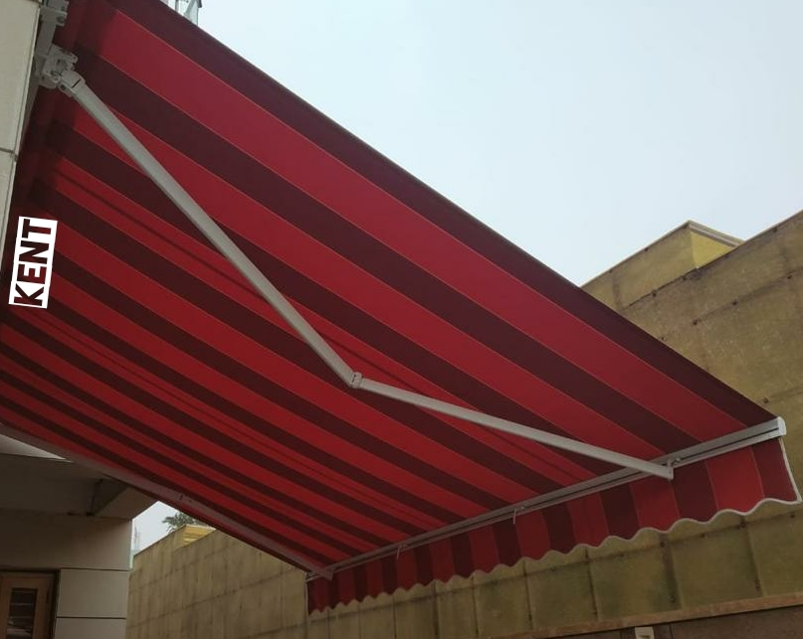
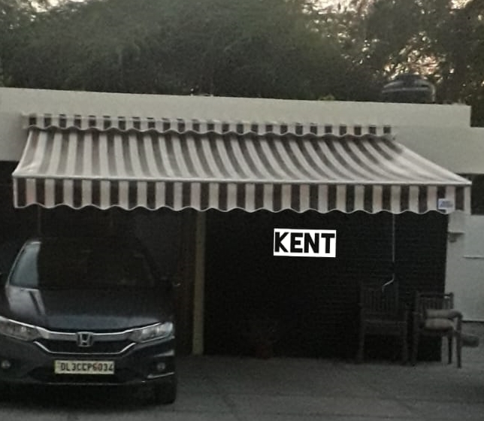
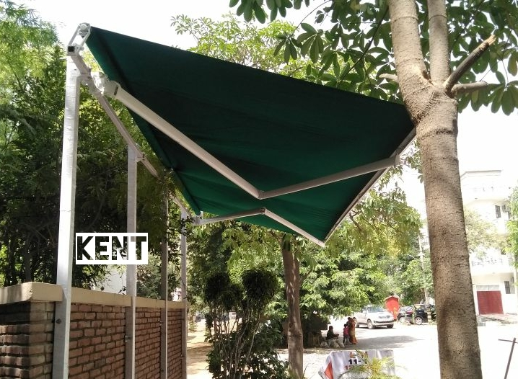
RETRACTABLE AWNING
Most favourite & hot selling product
Cantilever designs
Supported only on one side
Mostly used to cover balconies, patio, courtyard etc
Structure is made of aluminium
Available in anodised & powder coated options
Fabric procured from France, Spain & Italy
Saves from heat & rain
Manual as well as motorised options available

Slide 5
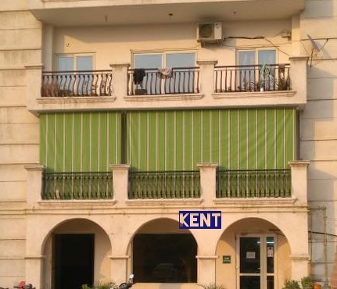
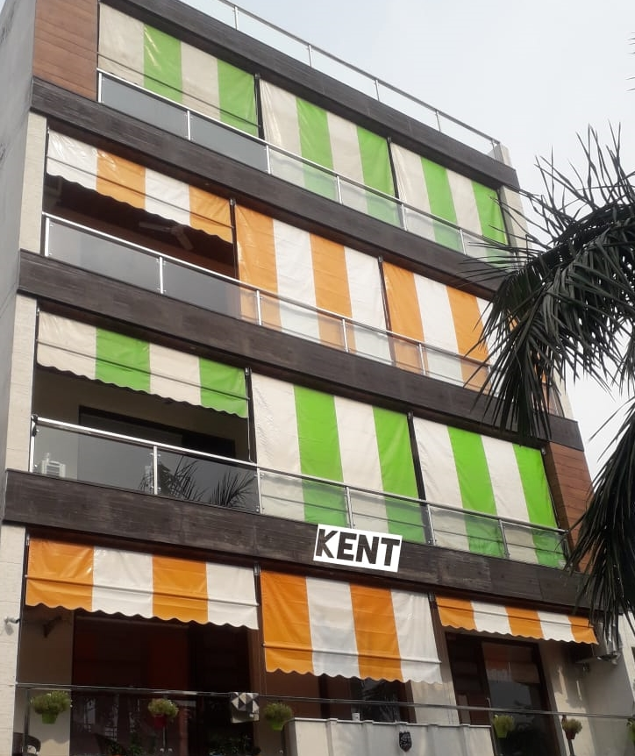
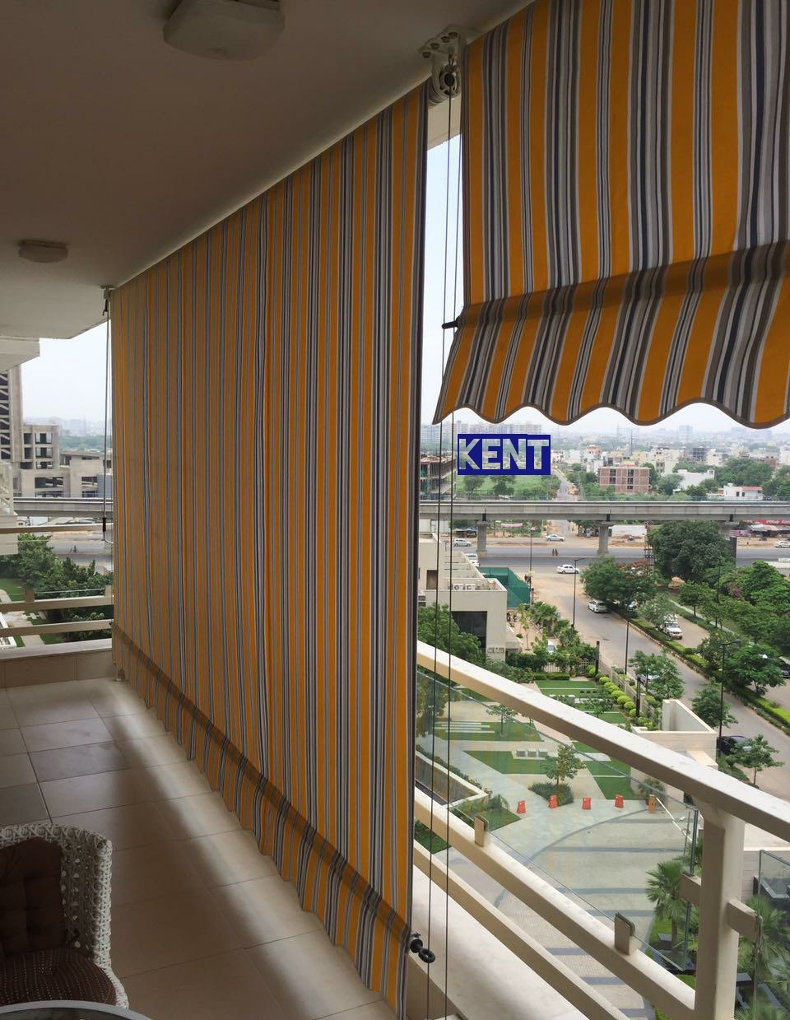
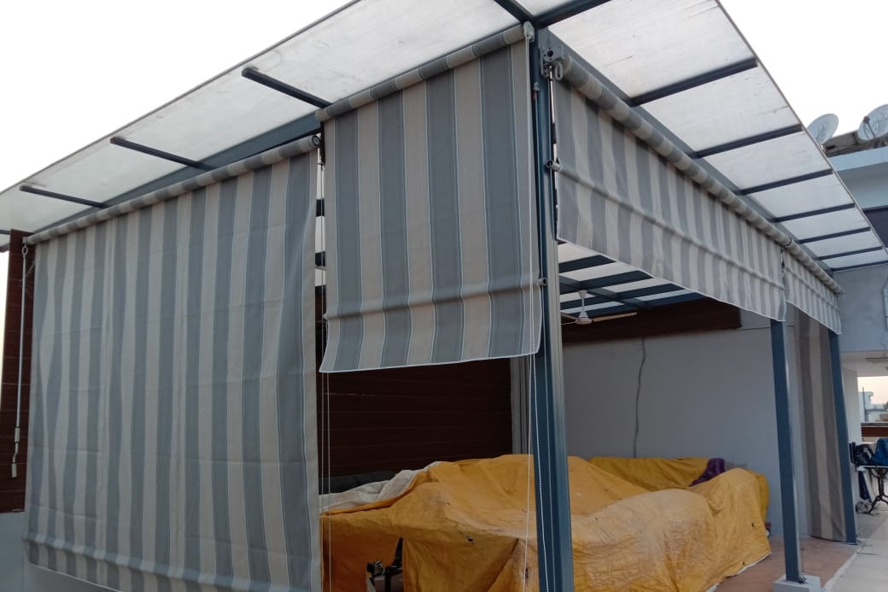
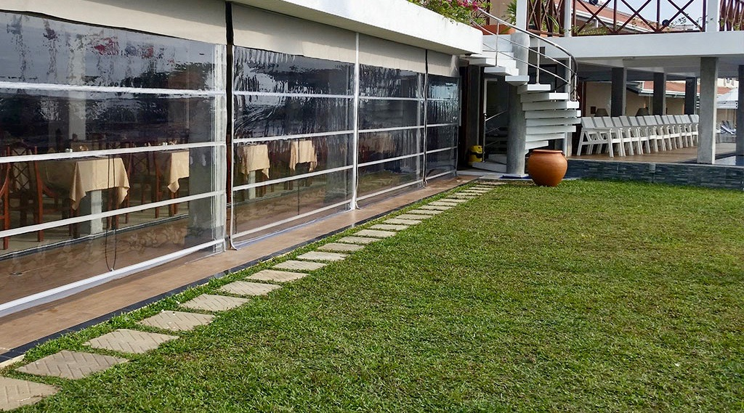
VERTICAL AWNING
Roll up & roll down awnings
Favourite with high rise buildings
Manual & motorised options are available
Can also be made in transparent fabric
Rough wire at sides to limit the flapping of fabric
Gives maximum privacy

Slide 6
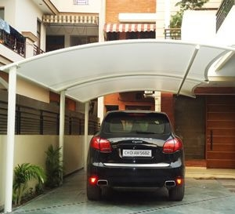
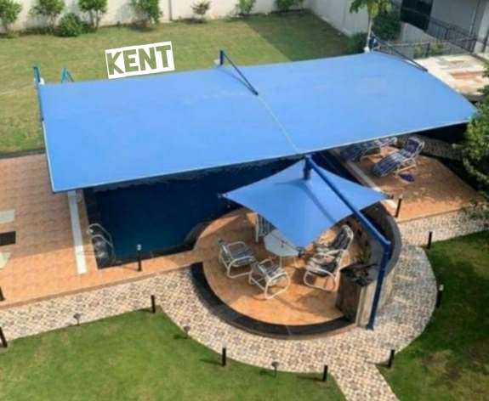
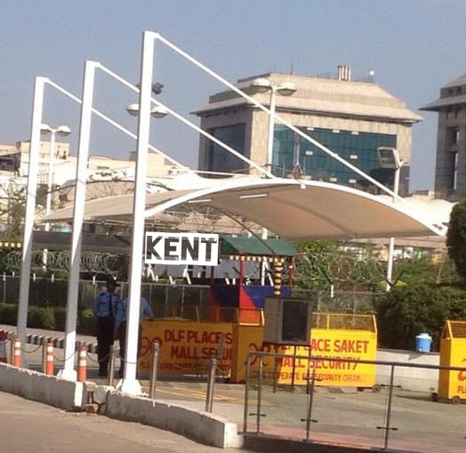
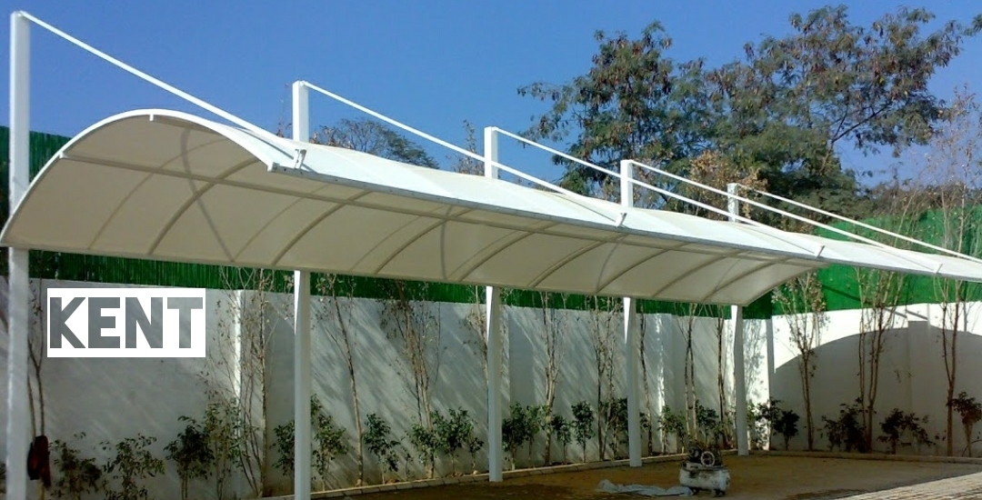
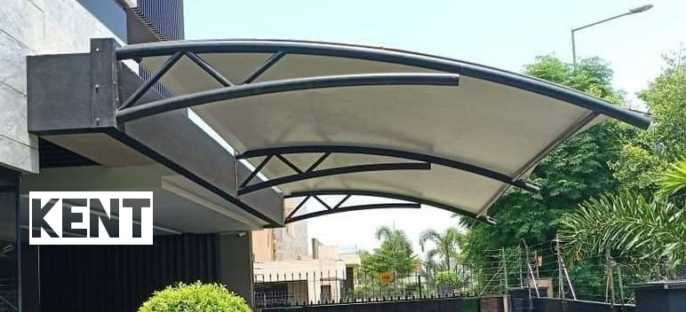
TENSILE & CAR PARKING AWNING
No limit of size
No fear of aero dynamics
Most sturdy MS structure
Main application areas are car parking , mall entrance, atriums , walkways etc
Super finished aesthetic designs are a pleasure to watch
Heavy tensile fabric is used
Fabric is fire retardant & UV protected
Fabric procured from France & Spain

Slide 7
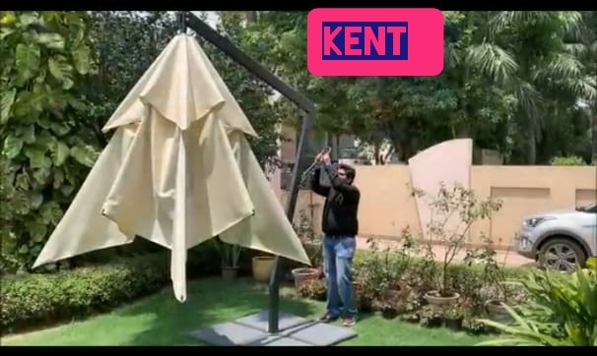
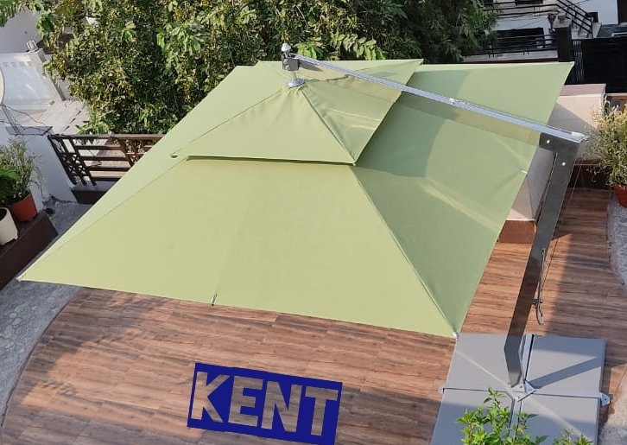
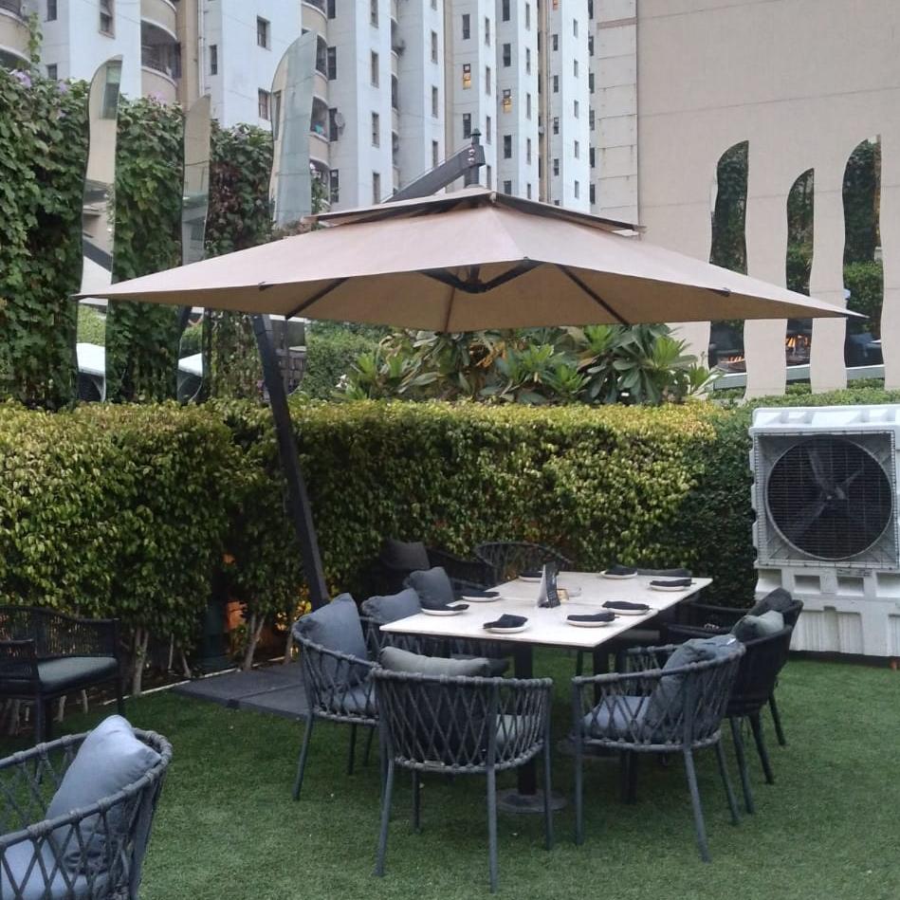
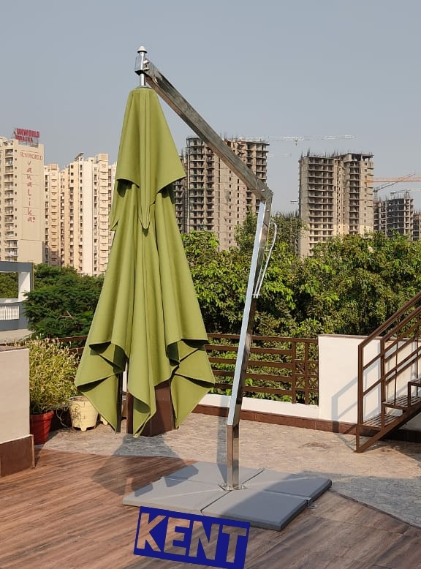
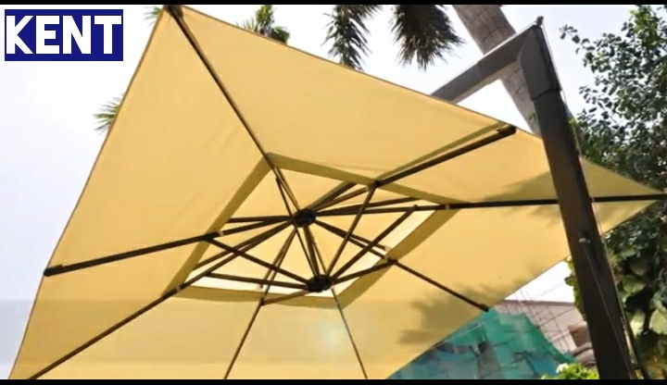
GARDEN UMBRELLAS
Perfect combination of Aesthetics , beauty & utility
SS or MS powder coated structure
Can easily seat 8 to 10 people
Water & heatproof fabric
Easily portable
Bottom weight of 160 kgs
With diameter of 8 to 10 ft
Side pole support

Slide 8
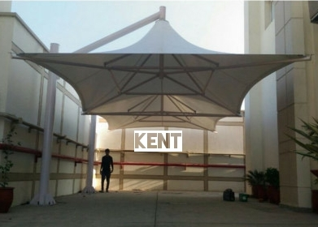
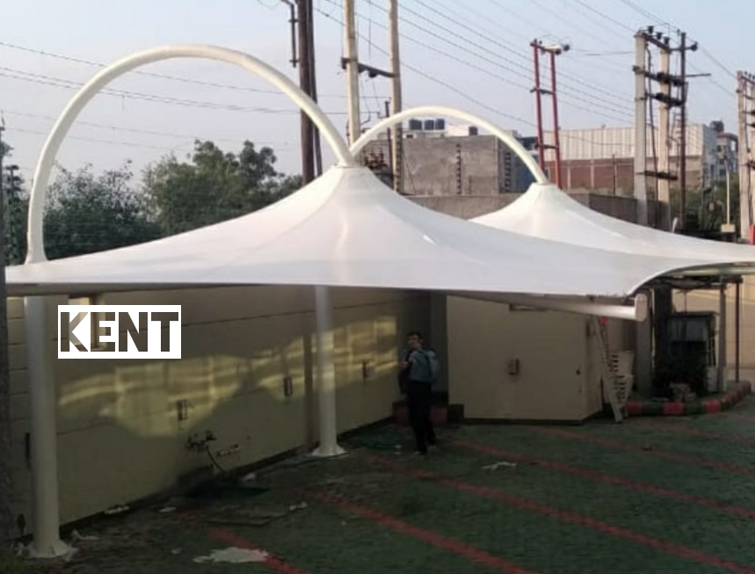
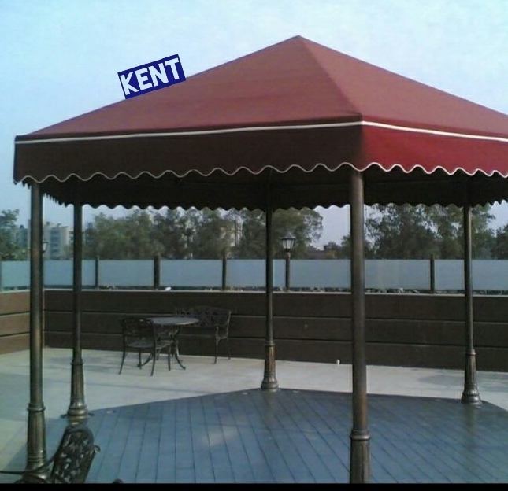
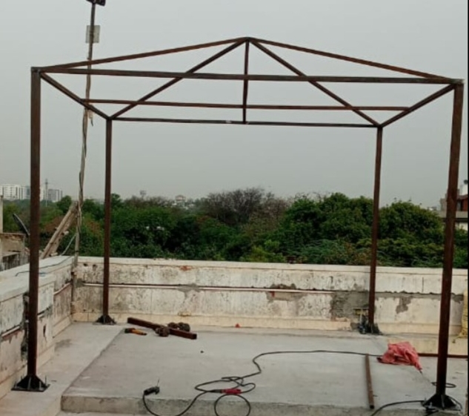
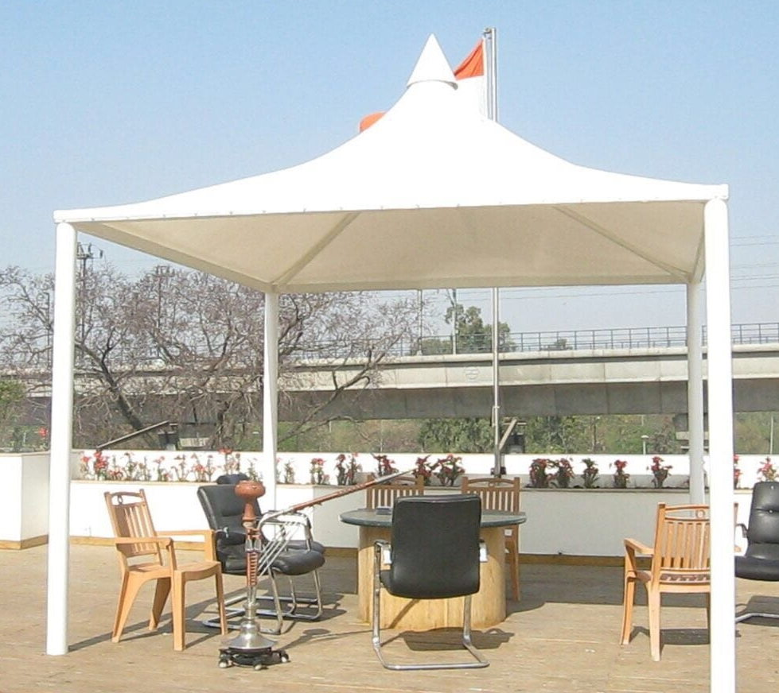
GAZEBO AWNING
Provides a perfect cosy sitting place
Favourite with rooftop or garden areas
Can also be supported on a single pole
Lighting can be done on the poles to give a vibrant look
Very sturdy MS section
Can be made in very trendy & modern shapes

Slide 9
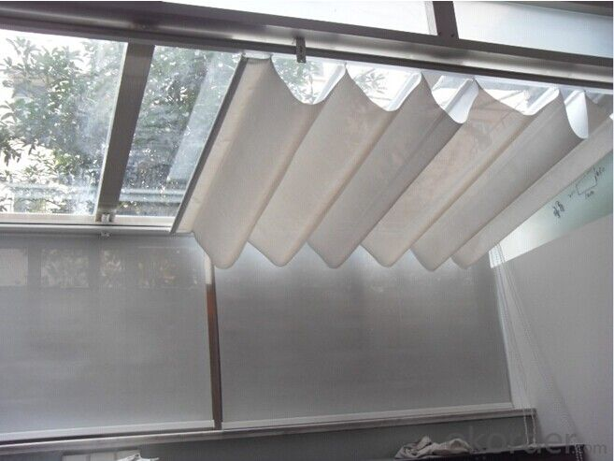
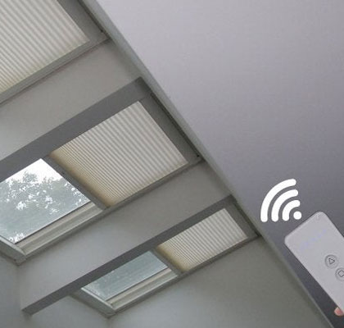
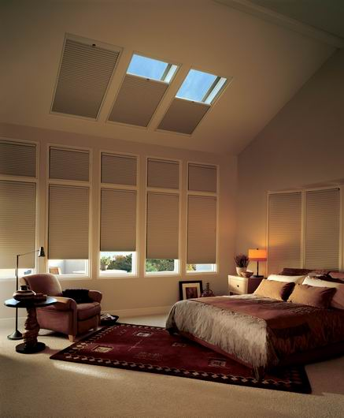
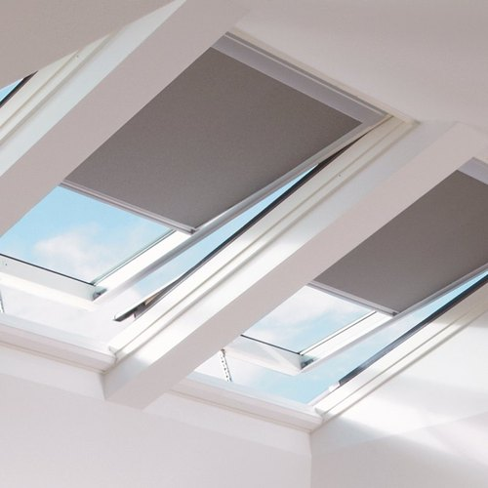
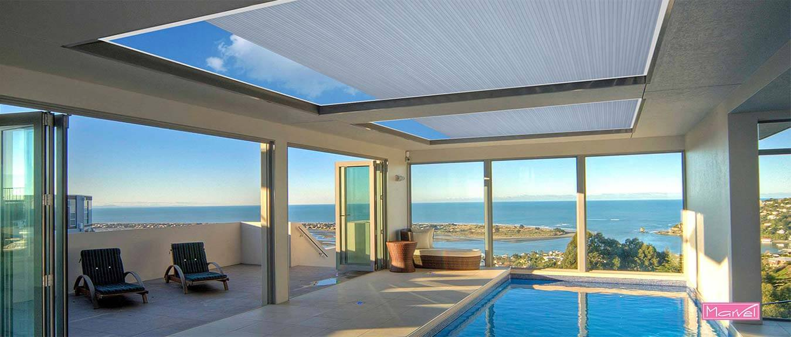
SKYLIGHT AWNING
Best solution to cover glass ceiling from inside
Favourite with architects & interior designers
Movement of blinds within aluminium channel frame
Fabric used is UV protected
Cuts light & Sun at will
Only available in motorised option
Gives ample openness feel when retracted back

Slide 10
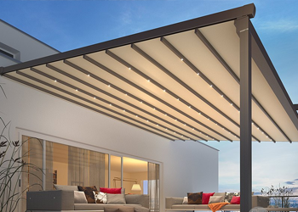
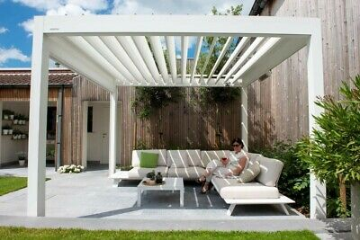
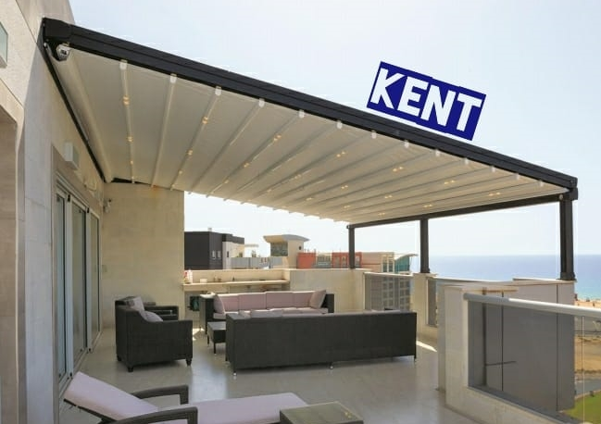
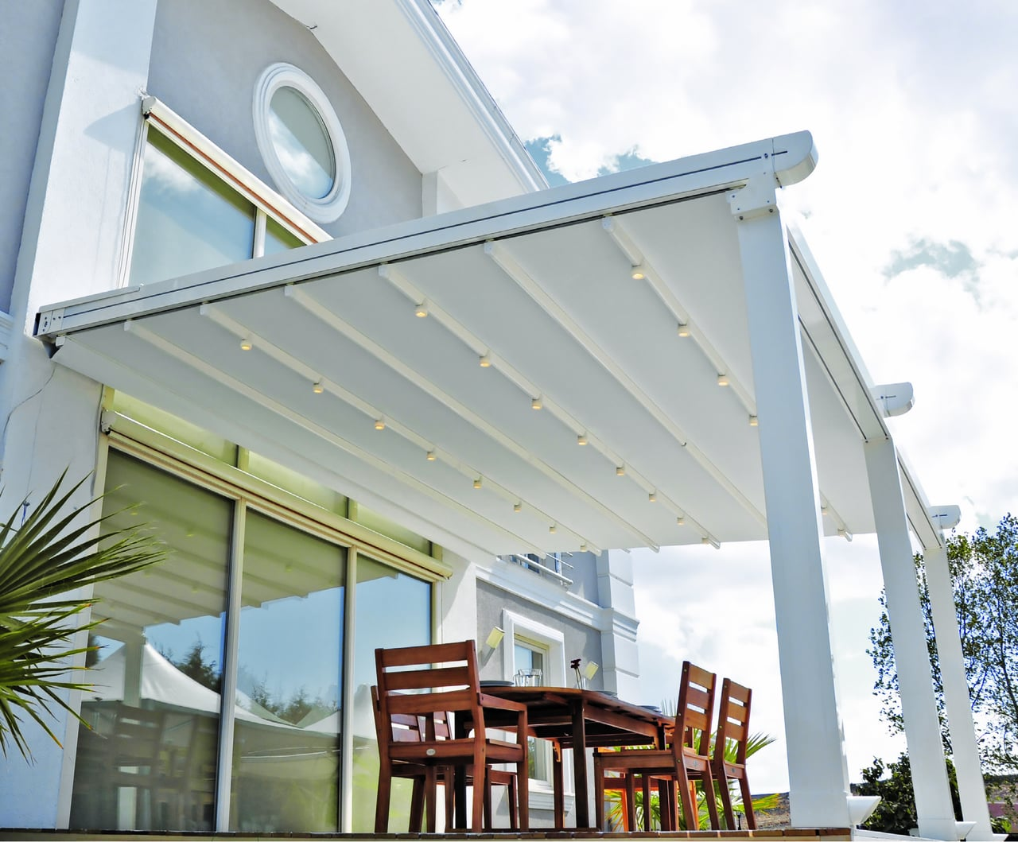
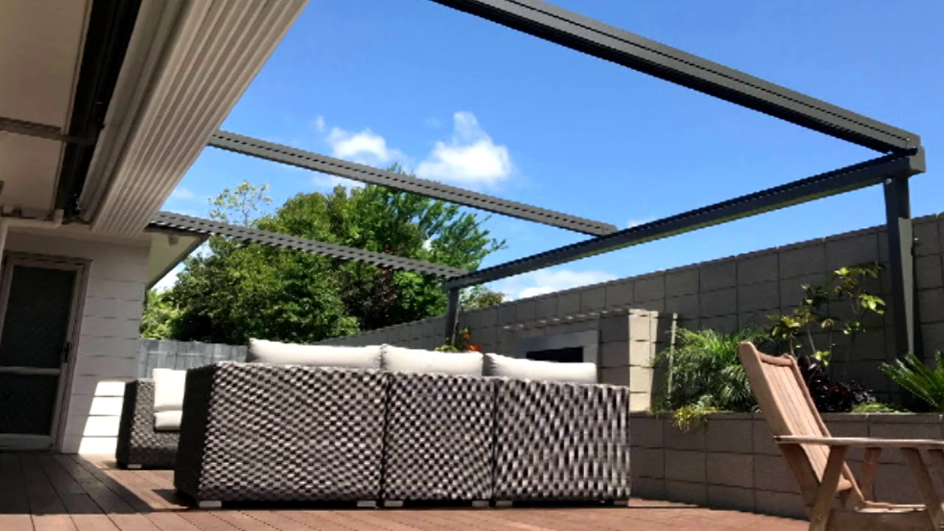
RETRACTABLE ROOF AWNING
Sturdy version of retractable awning
Powder coated aluminium frame on all 4 sides with front support pillars
Both aluminium slats & fabric coverings are available
Can take larger span than a traditional awning
Obvious choice for high velocity wind areas
LED lights , Motorised mechanism makes it a users delight

Slide 11

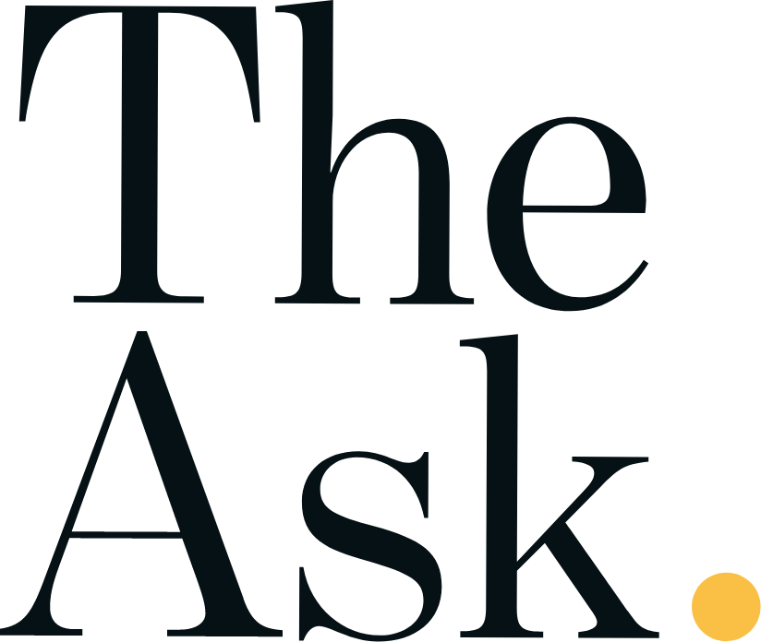
INOX
SAGA CUISINES
NORWAY EMBASSY
SOCIETY OF INDIAN AUTOMOBILE MANUFACTURERS
INDIA INTERNATIONAL CENTER
HIS HOLINESS THE DALAI LAMA
LPS BOSSARD
STEP BY STEP SCHOOL
UNITED PRESSURE COOKERS
MAYUR SCHOOL
Four points by Sheraton hotel
Taj Palace hotel , New Delhi
Builders
Architects
Interior Designers
Government projects
Hoteliers
Restaurant Chain owners

